Slide 1
Lecture 25
Laplace Transform
Hung-yi Lee

Slide 2
Reference
Textbook 13.1, 13.2
Notes:
Do Laplace transform by MATLAB
http://www.seas.upenn.edu/~ese216/handouts/Chpt13LaplaceTransformsMATLAB.pdf
http://www2.ensc.sfu.ca/people/faculty/ho/ENSC805/laplace2sided.pdf
https://www.youtube.com/watch?v=ZGPtPkTft8g&index=3&list=PLUMWjy5jgHK3jmgpXCQj3GRxM3u9BmO_v

Slide 3
Laplace Transform
Motivation and Introduction

Slide 4
Laplace Transform
Time domain
Laplace Transform ( L[f(t)] )
s-domain
Inverse Laplace Transform (L⁻¹[F(s)])
Notes:
f(t) can be real or even complex
One-side

Slide 5
Note
Always 0?
When f(0)=∞, it may not be zero

Slide 6
Note
Time domain
Laplace
Transform (L)
s-domain
When t≥0
=
Inverse Laplace
Transform (L⁻¹)

Slide 7
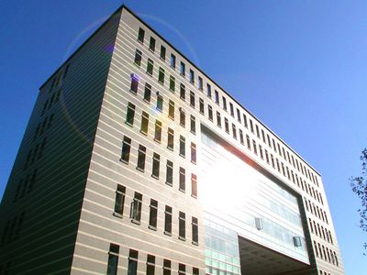
Domain
Different domains means view the same thing in different perspectives
Position:
台北市羅斯福路四段一號博理館
25°1'9"N 121°32'31"E

Slide 8
Domain
Different domains means view the same thing in different perspectives
Linear Algebra:

Slide 9
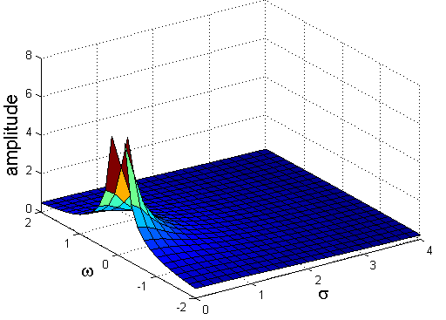
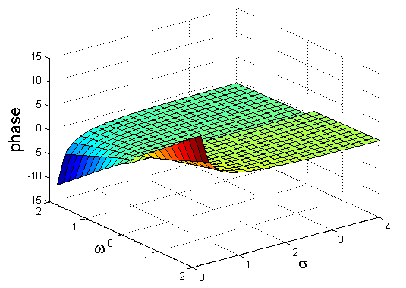
Domain
Transform: switch between different domains
Muggle
Time domain
Signal
Engineer
Laplace
Transform
Inverse Laplace
Transform
s-domain

Slide 10
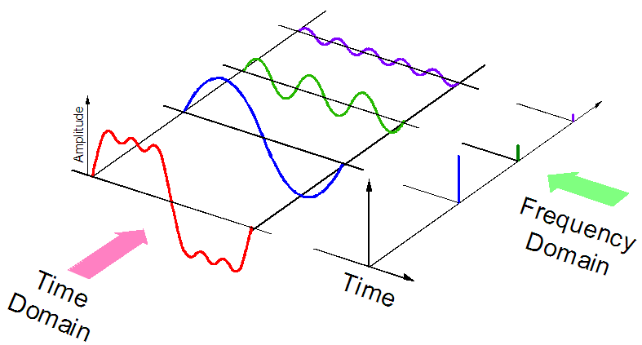
Fourier Series

Slide 11
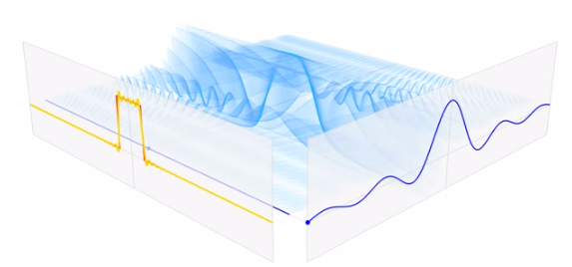
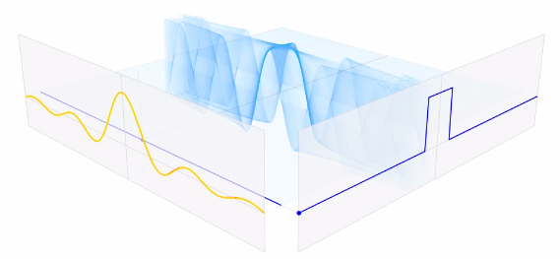
Fourier Transform
https://www.youtube.com/watch?v=r4c9ojz6hJg
Time
Domain
Frequency
Domain
Time
Domain
Frequency
Domain
Notes:
sinc function

Slide 12
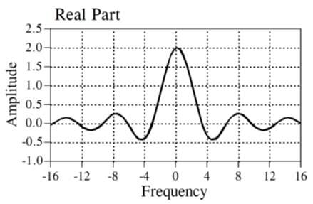
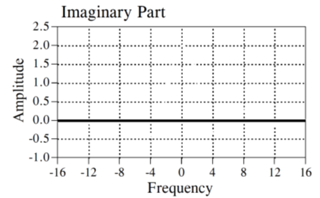
Fourier Transform

Slide 13
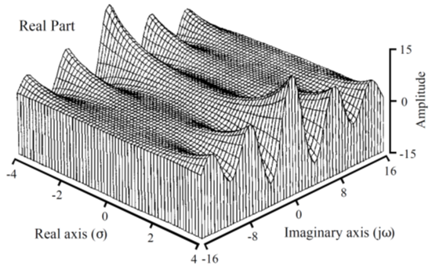
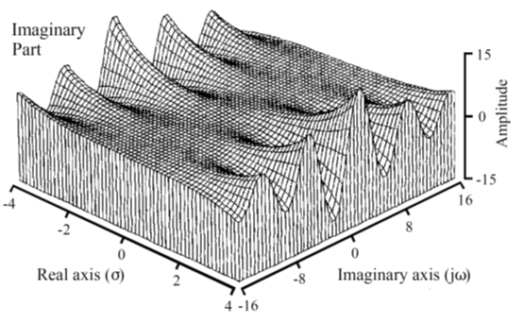
Laplace Transform

Slide 14
Laplace Transform
v.s.
Fourier Transform
Laplace Transform of f(t)
=
Fourier Transform:
Fourier Transform of f(t)e^{-σt}u(t)
Laplace Transform:

Slide 15
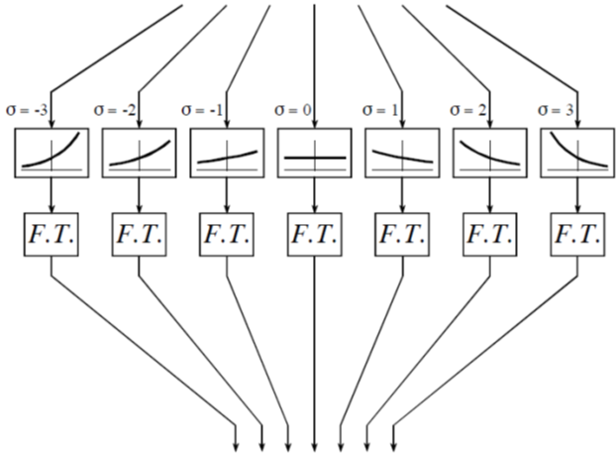
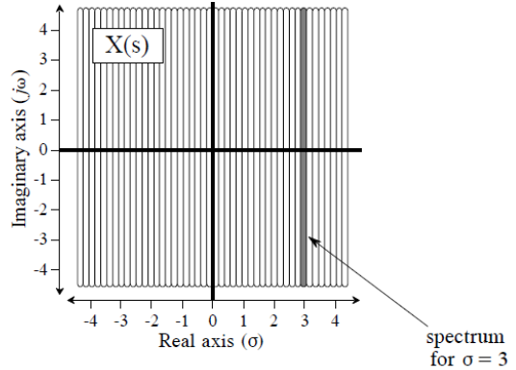
Laplace Transform v.s.
Fourier Transform
Multiply e^{-σt}
Multiply u(t)
Do Fourier Transform

Slide 16
Transformable Function
All Functions
Laplace Transform
Fourier Transform
Fourier Series
Periodic Functions

Slide 17
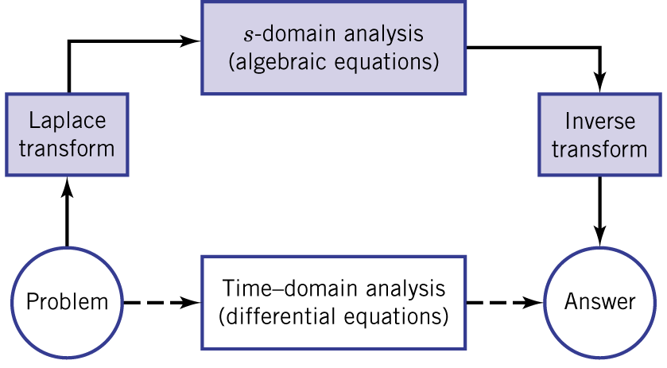
Why we do Laplace transform?

Slide 18
Transfer Function
H(s)
(circuit, filter …)
Laplace transform can help us find y(t) easily

Slide 19
Transfer Function
The signal with complex frequency s₀ = σ₀ + ω₀
H(s)
(circuit, filter …)

Slide 20
Transfer Function
(z is complex)
H(s)
H(s)
(H(s₀) is complex)

Slide 21
Transfer Function
H(s)
We do not know y(t), but we know its Laplace transform

Slide 22
Transfer Function
H(s)

Slide 23
Laplace Transform
Laplace Transform Pairs

Slide 24
Laplace Transform Pairs (1/4)
If Re[s]=σ>0
Time domain: 1
s-domain: 1/s
Time domain: u(t)
ROC: σ > 0
(Only consider t>0)
ROC

Slide 25
Laplace Transform Pairs (2/4)
If Re[a+s]=a+σ>0
Time domain: e^{-at}
s-domain: 1/(s+a)
-a
ROC: σ > -a
ROC

Slide 26
Laplace Transform Pairs (3/4)
If Re[s]=σ>0

Slide 27
Laplace Transform Pairs (4/4)
If Re[s]=σ>0

Slide 28
Summary of Transform Pairs
Time domain
s-domain
The 4 transform pairs are sufficient to imply all transform pairs in Table 13.2.
    More complete Transform Pairs: http://www.vibrationdata.com/math/Laplace_Transforms.pdf

Slide 29
Note: Impulse function
What is L⁻¹[1]? L⁻¹[1]=δ(t) (impulse function, Dirac delta function)
Notes:
Leave the proof?
How about 2
https://www.khanacademy.org/math/differential-equations/laplace-transform/properties-of-laplace-transform/v/laplace-transform-of-the-dirac-delta-function

Slide 30
Laplace Transform
Properties
The six properties in Table 13.1 (P585)

Slide 31
Property 1: Linear Combination
Let L[f(t)]=F(s) and L[g(t)]=G(s)

Slide 32
Property 2: Multiplication by e^{-at}
Let L[f(t)]=F(s)
Multiplication
by e^{-at}
-a
ROC
ROC
Notes:
Replace s by s+a
Shift to the left by a

Slide 33
Property 3: Multiplication by t
Let L[f(t)]=F(s)

Slide 34
Property 4: Time Delay
Delay by t₀ and
zero-padding up to t₀

Slide 35
Property 5: Differentiation
Integration by parts:
Let L[f(t)]=F(s)
v’
u
v
u
v
u’
Notes:
How about the second order differentiation? P584 (13.13b)

Slide 36
Property 5: Differentiation
Let L[f(t)]=F(s)
Example

Slide 37
Property 5: Differentiation
……

Slide 38
Property 6: Integration
Let L[f(t)]=F(s)
(You can use integration by parts as in P584)

Slide 39
Property 6: Integration
Let L[f(t)]=F(s)
Notes:
Thanks ……

Slide 40
  Laplace Transform Properties
  Table 13.1 Laplace Transform Properties (P585)
  Operation Time Function Laplace Transform

Slide 41
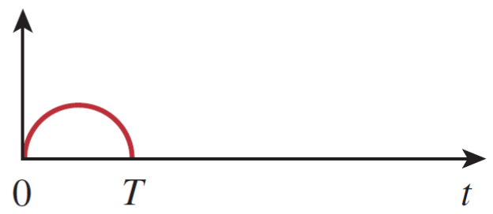
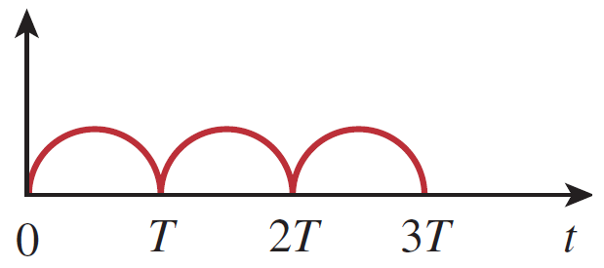
More properties (in Homework)
Time-scaling property
Integral of F(s)
Periodic function
f(t)=0 outside 0<t<T
…..

Slide 42
  Table 13.2 Laplace Transform Pairs (P585)
  f(t) F(s)

Slide 43
  Table 13.2 Laplace Transform Pairs (P585)
  f(t) F(s)

Slide 44
Example for Periodic function

Slide 45
  Table 13.2 Laplace Transform Pairs (P585)
  f(t) F(s)
……

Slide 46
  Table 13.2 Laplace Transform Pairs (P585)
  f(t) F(s)

Slide 47
Note: Euler’s formula

Slide 48
Note: Multiplication

Slide 49
Laplace Transform
Inverse Laplace Transform

Slide 50
Partial-Fraction Expansions
Rational Function
s₁, s₂, ……, s_{n} are the roots of D(s) ( poles of F(s) )
One pole, one term
We only consider the case that m < n.
(strictly proper rational function)
Notes:
What happen if m=n or m>n

Slide 51
Partial-Fraction Expansions
Rational Function
If m = n
δ(t)
1
If m = n + 1
differentiate
multiply s
dδ(t)/dt ……
s
Notes:
What happen if m=n or m>n

Slide 52
Partial-Fraction Expansions
Rational Function
There are three tips you should know.

Slide 53
Tip 1: How to find A₁,A₂,∙∙∙∙∙∙∙,A_{n}
  Example 13.5
Panacea: reduce to a common denominator, and then compare the coefficients

Slide 54
Tip 1: How to find A₁,A₂,∙∙∙∙∙∙∙,A_{n}
  cover-up rule

Slide 55
Tip 1: How to find A₁,A₂,∙∙∙∙∙∙∙,A_{n}
  Example 13.5: cover-up rule
Take A₂ as example. Multiplying s+2 at both sides
Set s=-2:
Notes:
Cancel first
Find A1 and A3 by yourself

Slide 56
Tip 2: For Complex Poles
Example 13.6:
Find f(t) = L⁻¹[F(s)]
It is not easy to find A₂₁ and A₂₂.
Set s=-3+j4 to find A₂₁…….

Slide 57
Tip 2: For Complex Poles
Example 13.6:
Find f(t) = L⁻¹[F(s)]
Do not split the complex poles
Find B and C

Slide 58
Tip 2: For Complex Poles
Example 13.6:
Find f(t) = L⁻¹[F(s)]
Do not split the complex poles
Find B and C
(another approach)

Slide 59
Tip 2: For Complex Poles
Example 13.6:
Find f(t) = L⁻¹[F(s)]
Find
(Refer to P593)

Slide 60
Tip 3: Repeated Poles
Exercise 13.31
order=3
order=2
?

Slide 61
Tip 3: Repeated Poles
Exercise 13.31
We cannot find A2 by multiplying (s+3)
(Refer to P596 – 597)

Slide 62
Tip 3: Repeated Poles
Exercise 13.31

Slide 63
Exercise 13.10
Time delay
L⁻¹
L⁻¹
Delay by 8 and
zero-padding up to 8

Slide 64
Exercise 13.10
Time delay
L⁻¹
L⁻¹
Delay by 8 and
zero-padding up to 8

Slide 65
Exercise 13.10
Time delay
L⁻¹
L⁻¹
L⁻¹
L⁻¹
Delay by 8 and
zero-padding up to 8

Slide 66
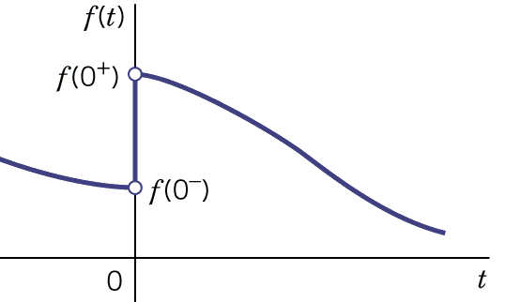
Initial and Final Values
We can find the value f(0⁺) and f(∞) from F(s)
We know
Initial-value Theorem
Because F(s) is strictly proper,
is defined.
Notes:
Which functions do not have the final values?

Slide 67
Example 13.9
Find the initial value f(0⁺)

Slide 68
Example 13.9
Find the initial slope f’(0⁺)
∞ - ∞ ?

Slide 69
Initial and Final Values
We can find the value f(0⁺) and f(∞) from F(s)
We know
Initial-value Theorem
Because F(s) is strictly proper,
is defined.
If the final value exists
(Can be known from the poles)
Final-value Theorem
Notes:
Which functions do not have the final values?

Slide 70
Final Values
4 regions
Region B
Region A
Region D
Region C

Slide 71
Final Values
Region A
a>0
No final value
a>0
No final value
b<0
α<0
No final value

Slide 72
Final Values
Region B
Final value = 0
a<0
a<0
Final value = 0
b>0
α>0
Final value = 0

Slide 73
Final Values
Region C
No final value

Slide 74
Final Values
Region D
final value = constant
No final value
Summary for Final Values
(P601)
Final value exists
(1) Poles on the left plane, or (2) single pole at the origin
single pole at the origin
Non zero final value

Slide 75
Final Values
Final-value Theorem
The final-value theorem gives the wrong answer when the final value does not exist.
Only one pole
The final value not exists
The final value exists iff the poles are in this region
The final value not exists

Slide 76
Final Values
Final-value Theorem
The final value is not zero iff there is only one pole at the origin
Only one pole
The final value is 0
The final value is A
The final value is clearly A
The final value exists iff the poles are in this region

Slide 77
Example 13.9
Find the final value
Four poles: 0, -10, -4+8j, -4-8j
The final value exists.
The final value is not zero.

Slide 78
Laplace Transform
Application

Slide 79
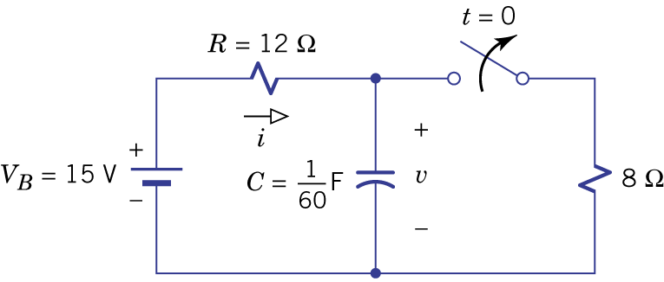
Differential Equation
Find v(t)

Slide 80
Differential Equation

Slide 81
Homework
13.6, 13.9, 13.10, 13.16, 13.25, 13.28, 13.35, 13.38. 13.46

Slide 82
Thank you!

Slide 83
Answer
13.6: derive by yourself
13.9: proof by yourself
13.10: proof by yourself
13.16: F(s)=2(1-3se^{-2s}-e^{-3s})/s²
13.25: f(t)=-2+5e^{-2t}-3e^{-4t}-e^{-6t}
13.28: f(t)=5-5e^{-4t}+10e^{-3t}cos(t-36.9。)
13.35: f(t)=2te^{-t}cos(2t-180 。)
13.46: f(0+)=2, f’(0+)=-5, f(∞) not exist

Slide 84
Appendix

Slide 85
Fourier Series
Periodic Function: f(t) = f(t+nT)
Fourier Series:
Notes:
Finite dis
Finite max & min
Finite integrate

Slide 86
Laplace Transform Pairs (1/4)
σ=0
0
ω
?

